Slide 1


Insights across disciplines: What do Duke students believe about intelligence?
Christina Bejjani, Brenda Yang
BRITE Ideas
December 4, 2019

Slide 2

Roadmap
Our research questions
Lessons from classroom research
A few results
Questions & discussion

Slide 3
Roadmap
Our research questions
Lessons from classroom research
A few results
Questions & discussion

Slide 4
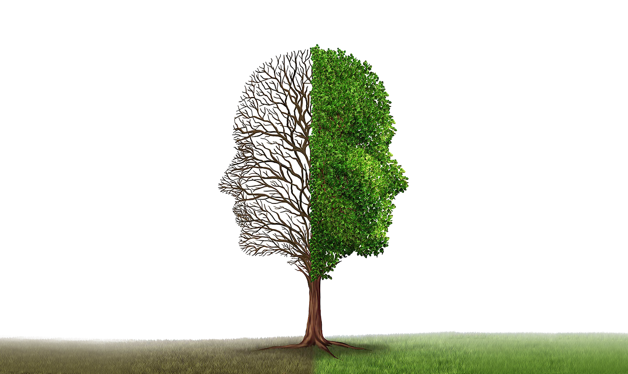

Slide 5
Intelligence is fixed.
Intelligence can be grown.
Embrace challenges
Likely to persist in the face of setbacks
Effort is the path to mastery
Avoid challenges
Give up easily
Effort signifies a lack of talent

Slide 6

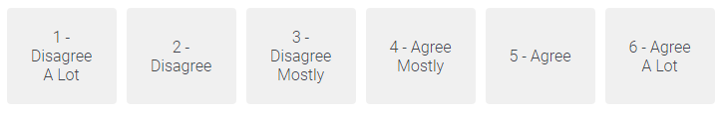

You can always greatly change how intelligent you are.
TOI
scale
[1-6]

Slide 7
Describe someone you think of who is intelligent.
Type 1 – 3 sentences

Slide 8
Do you think of yourself as intelligent? Why or why not?
Type 1 – 3 sentences

Slide 9
What do you think caused you to have your current level of intelligence?
Type 1 – 3 sentences

Slide 10
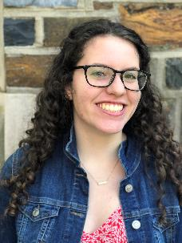
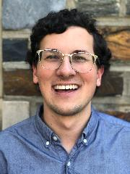
Do you think you are intelligent? Why or why not?
Yes, because I can learn things really quickly, catch on to things pretty quickly
fixed
What caused to you have your current level of intelligence?
I think it's genetics. Both of my parents went to a top university, and my grandparents are intelligent

Slide 11
Do you think you are intelligent? Why or why not?
I think that I am a hard worker and that that has made me successful as opposed to innate intelligence. I try my best to use problem-solving skills.
growth
What caused to you have your current level of intelligence?
I think my upbringing caused me to have the level of intelligence and awareness I have. I was very fortunate be surrounded by people that supported me from a young age.

Slide 12
Do you think you are intelligent? Why or why not?
In some cases yes, in other no.
mixed
What caused to you have your current level of intelligence?
I think intelligence in general is a combination of personal effort, natural affinity for a specific topic and genetics.

Slide 13

Can we detect beliefs about intelligence through language?
naturalistic measurement
identify “false mindsets”

Slide 14
Measurements: mindsets
TOI scale
open-ended text responses

Slide 15
Measurements: mindsets
TOI scale
open-ended text responses

Slide 16

“This person isn't very intelligent because … they lack the innate mental ability and have to work hard to get good grades”
“I think that this person is very intelligent because you can always make yourself smarter. If you put in more effort, you'll do better.”
TOI: 5.5
TOI: 5.0

Slide 17
Can we detect beliefs about intelligence through language?
naturalistic measurement
identify “false mindsets”
Is there pedagogical value to teaching about mindsets?

Slide 18

Does domain matter?
psychology, computer science, statistics, math, chemistry, physics
Do student perceptions of faculty mindsets matter?

Slide 19

Are non-performance measures predicted by mindset?
well-being
grade satisfaction
help-seeking behaviors

Slide 20



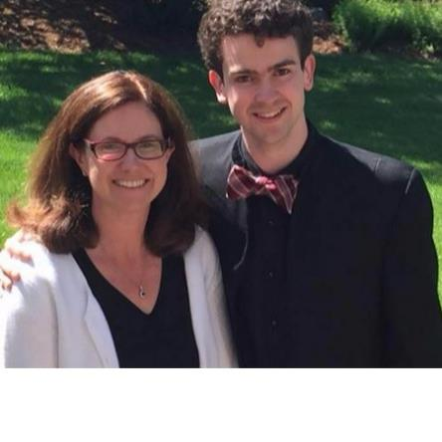


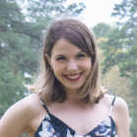

response coding team
teaching teams
Psy
101
CS101
Stats
101
Psy
201
Chem101
Phys
141
developers
Math 216
logistical help
researcher

Slide 21
Roadmap
Our research questions
Lessons from classroom research
A few results
Questions & discussion

Slide 22
Recruiting classroom collaborators
Screen STEM classes with large enrollments
Email faculty: collaborate with research, low effort for them, $500 honorarium
Meet in person to introduce project and set expectations

Slide 23
Survey schedule in classrooms
Beginning of semester
Mid-Semester
End of Semester

Slide 24

Lessons from classroom research
Use Qualtrics panels
Data wrangling is the primary challenge! Be organized.
Make it easy for yourself
Provide structure for your collaborators
Motivate students
If you want to use event logs/naturalistic data (e.g., Sakai, Piazza), specify hypotheses as much as possible
Proofread carefully

Slide 25
Roadmap
Our research questions
Lessons from classroom research
A few results
Questions & discussion

Slide 26
Sample sizes of classes
 | Psy101 | CS101 | Sta101 | Chem101 | Math216 | Phys141
Fa19 | 300 | 254 | 278 | 440 | 110 | 162
Sp19 | 215 | 224 | 225 | -- | -- | --
Fa18 | 251 | -- | -- | -- | -- | --

Slide 27
N-gram library
Fixed | Growth
easily, naturally, talent, talented, IQ, memory, fast, quickly, easy, born, gifted, ease, innate… | dedicated, passion, studious, practice, motivated, driven, diligent, thorough, eager, curious, interest, open-minded, adapt, flexible, malleable, explore challenge, improve, …
no effort, rarely studies, doesn’t need, never studies, book smart, good grades | push through, work hard, lifetime learner, open minded, love of, try again, tries again, give up, desire to…
too much time, always does better | willing to learn, strive to understand, excited about learning, learn from mistakes…

Slide 28
How does the n-gram library do?
233 are correct (out of 241)
8 are incorrect (out of 241)

Slide 29

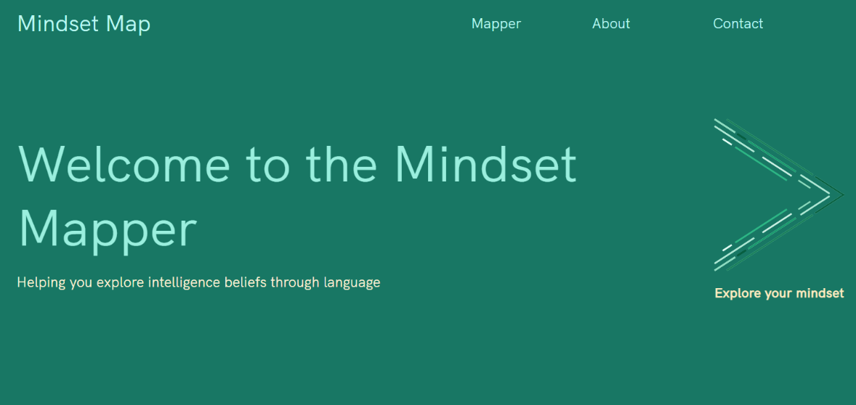
bit.ly/mindsetmapper

Slide 30
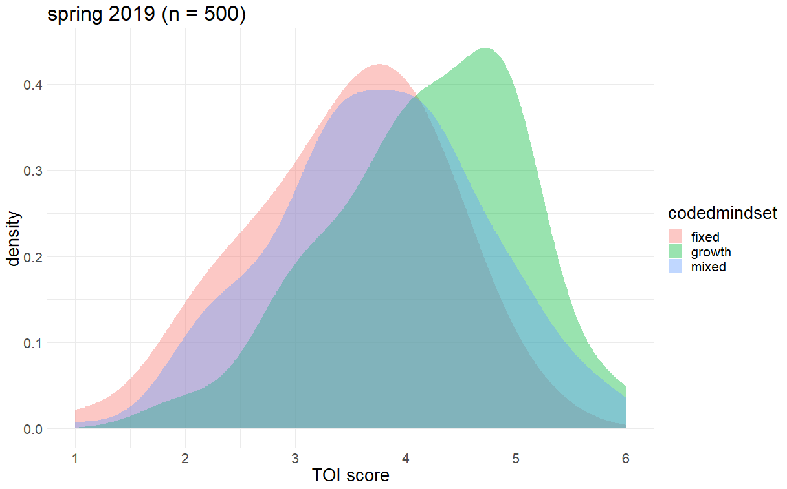
Coded mindset and TOI score (Spring 2019)
N = 500

Slide 31
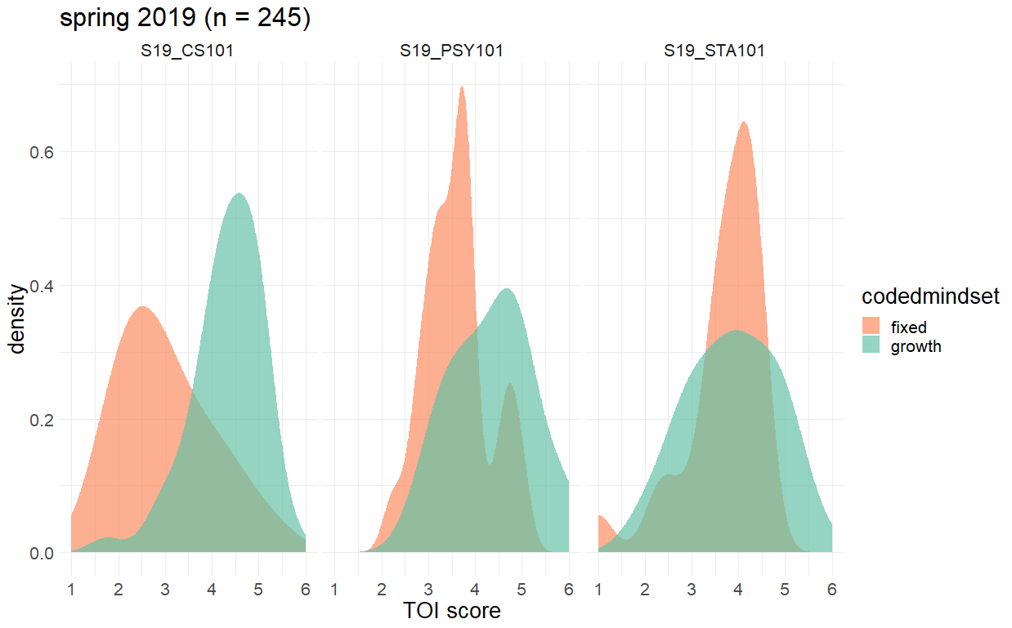
Coded mindset & TOI across CS, PSY, and STA
CS101
PSY101
STA101
M = 4.02
M = 3.71
M = 3.78
N = 245

Slide 32
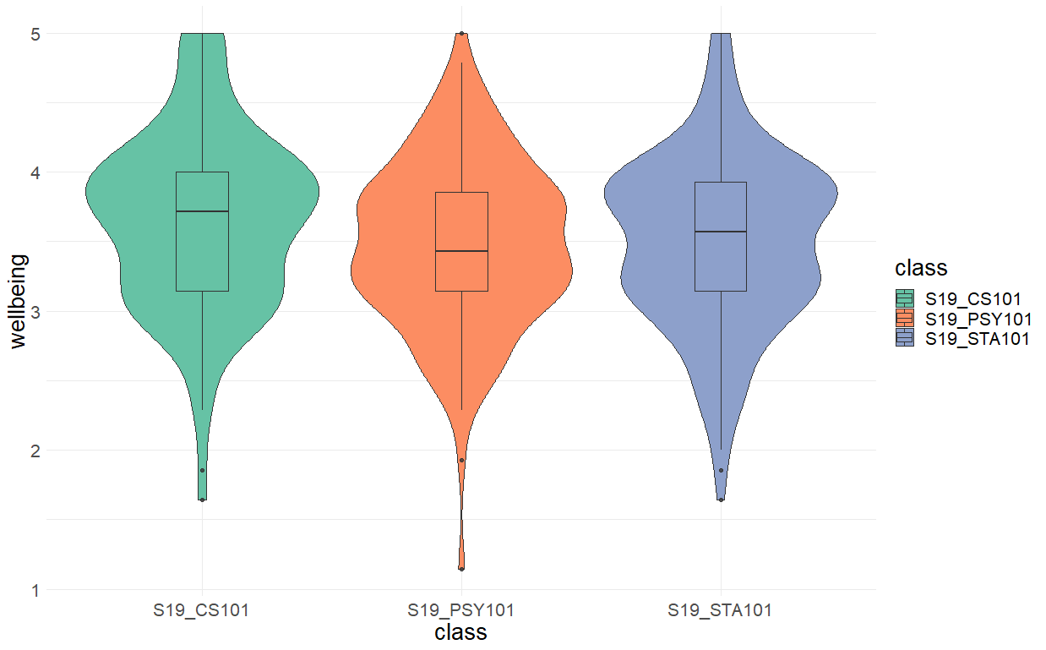
Well-being across classes

Slide 33
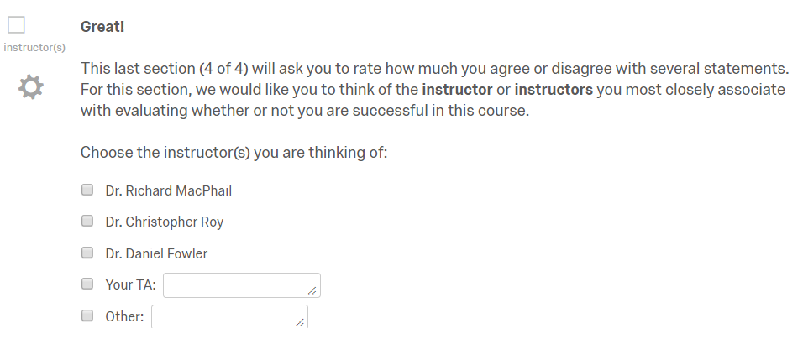
Perceptions of faculty mindset

Slide 34
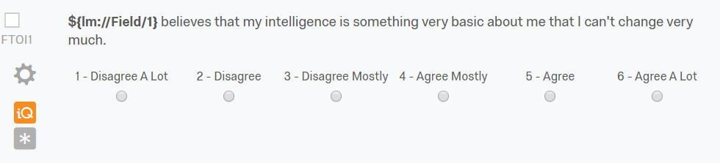
Perceptions of faculty mindset

Slide 35
Perception of faculty intelligence mindsets
 | Student ratings of faculty |  | Faculty’s TOI
Class1 (n = 302) | 4.28 | < | 4.75
Class1 (n = 51) | 4.26 | > | 3.50
Class2 (n = 114) | 3.89 | < | 4.50
Class2 (n = 50) | 4.70 | < | 5.50
Class3 (n = 98) | 4.07 | > | 2.75
Class4 (n = 203) | 4.56 |  | NA
Class5 (n = 104) | 4.68 |  | NA

Slide 36
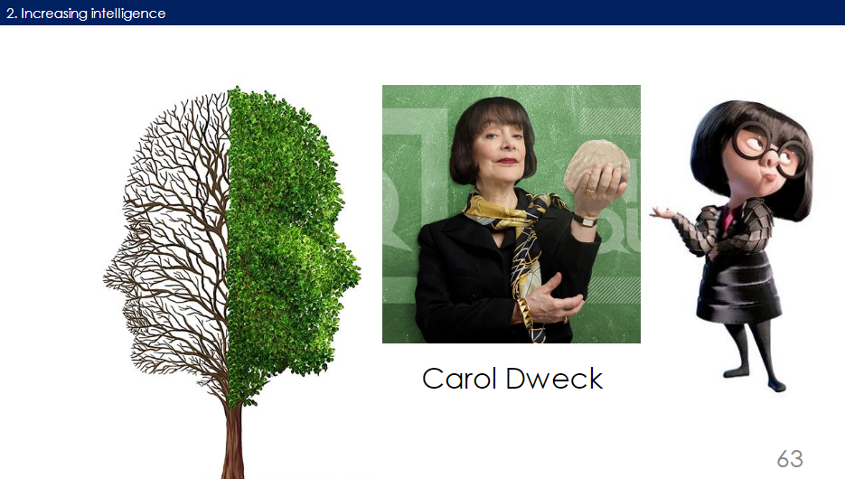
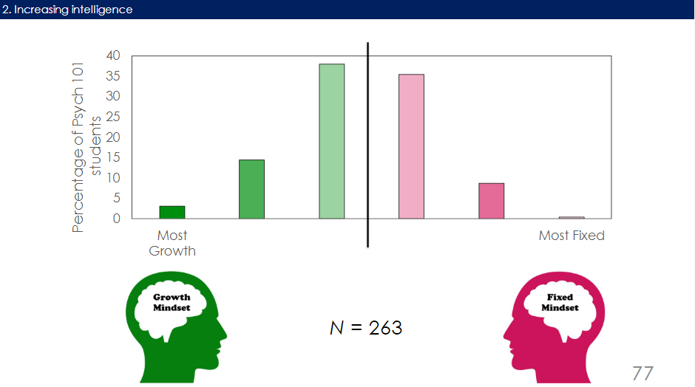
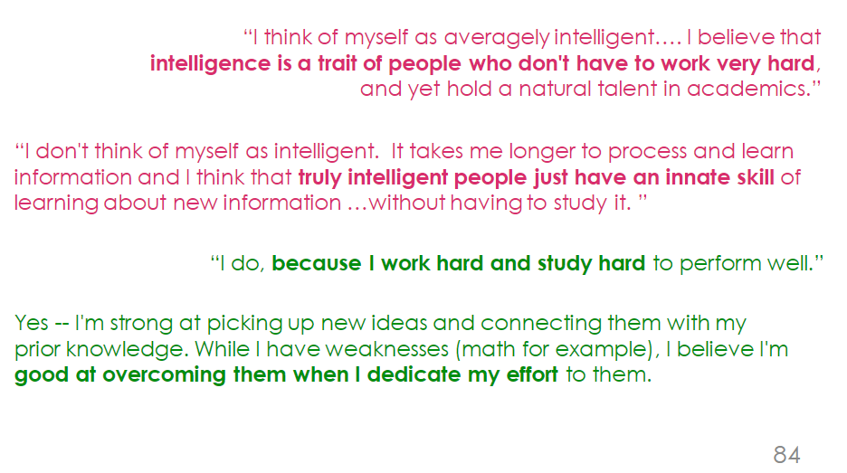

Slide 37
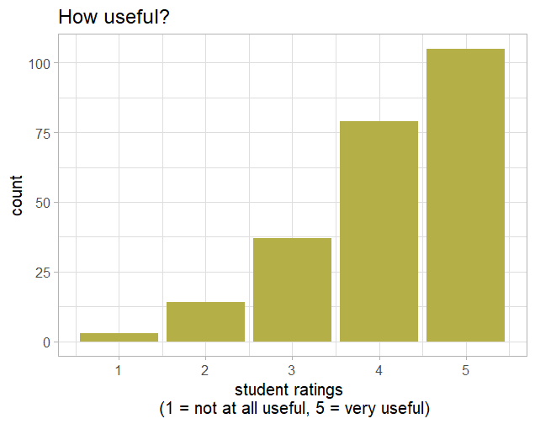
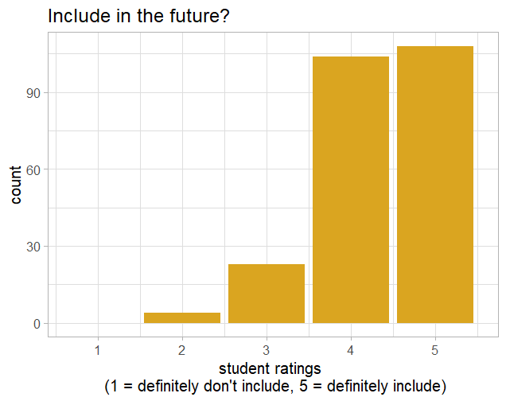
Survey of students: ratings
M = 4.11
SD = 0.96
232 students (92.4% of the introduction to psychology course)
“How useful was it to see student responses from the class?” (1 – 5)
“Would you advise the instructor to include this activity in future lessons on intelligence?” (1 – 5)
M = 4.31
SD = 0.71

Slide 38
Survey of students
Seeing class distribution helps contextualize their own responses
“It … showed that both mindsets really did exist, even right in our classroom.”

Slide 39
Planned analysis
Dependent measures of interest | Predictor variables of interest | Predictor variables
Course grade Grade satisfaction Well-being Naturalistic behaviors e.g. help-seeking Future course grades | Mindset: TOI, coded, algorithm Perception of faculty mindset Procrastination (logs analysis) | Previous GPA SAT score

Slide 40

Procrastination index
Submitted online
Assignment deadline
[ procrastination index ]

Slide 41
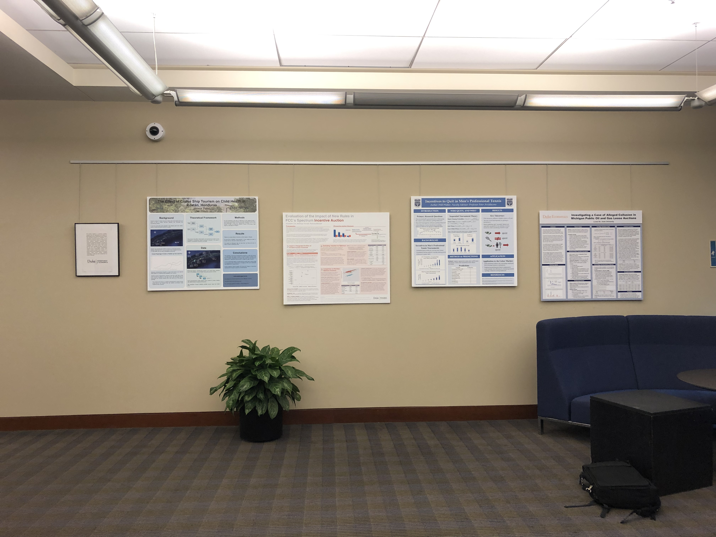
Outreach: February 2020 Libraries Exhibit

Slide 42
Talk
Our research questions
Lessons from classroom research
A few results
Questions & discussion

Slide 43
Insights across disciplines: What do Duke students believe about intelligence?
Christina Bejjani, Brenda Yang
BRITE Ideas
December 4, 2019

